Slide 1


GitHub + Visual Studio ❤ .NET
Vix Rian & Andy Sterland

Slide 2

Agenda
What are GitHub Codespaces?
How do they work?
Demo
Creating codespaces
New Git tooling
GitHub Actions
Customizations for codespaces
Types of customizations
Devinit tool
Demo

Slide 3

GitHub Codespaces + Visual Studio
Vix Rian
(they/them/theirs)
Program Manager, Microsoft
@vixgrows

Slide 4




What are GitHub Codespaces?
Managed environments for any project
Feel at home even when away
Develop from anywhere
Supercharged collaborative development
Fully-managed, on-demand dev environments that dramatically reduce setup and maintenance
Environment can be configured, and your settings, themes, and Git identity, are roamed so the experience looks and feels like local
Connect from anywhere: Visual Studio, Visual Studio Code, browser-based companion editor
Fully collaborative environment, complete with AI-assisted development support

Slide 5
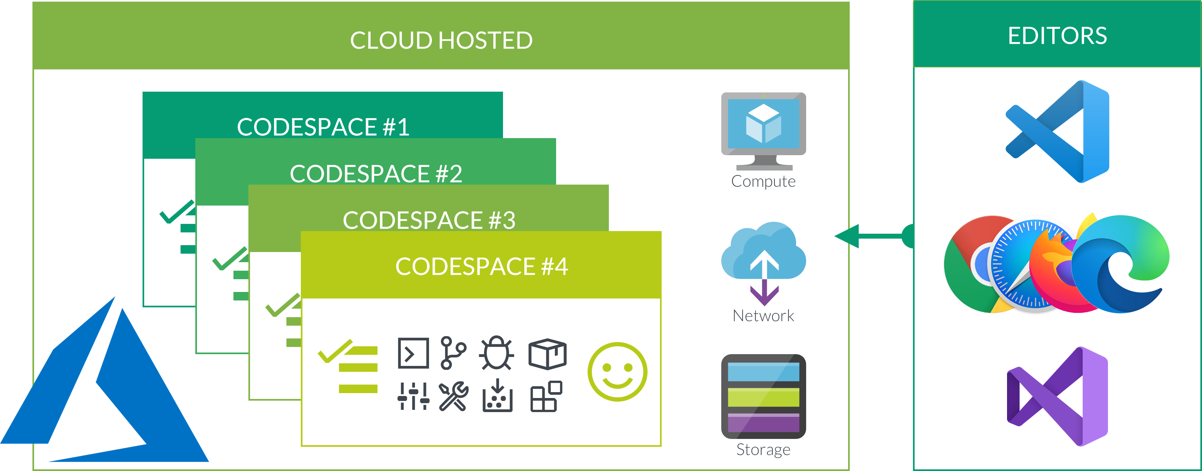

GitHub Codespaces
Cloud hosted
Editors
Notes:
What are the biggest questions I get?
What is local and what is in a codespace?
Imagine we took all the storage, compute, move to the cloud
Thin-front end will present the UI for your coding experience (VS, VS Code, browser)
This allows us to run on lightweight
“a-okay” terminology:
Windows-based VM
We wanted to enable native Windows apps, and to enable it to run with Visual Studio (as a windows app)
GitHub Codespaces for Visual Studio
It’s VS Code running in the web, you don’t get designer / tooling on omni-sharp ext. (a compliment to your visual studio experience)
Use for light weight activities and small changes

Slide 6

What to expect with my codespace
A codespace is the "backend" half of GitHub Codespaces.
Creating a codespace prepares everything you need to complete a task, review a PR, or start a new project.
Codespaces configure the runtime, compiler, debugger, editor, custom dotfile configurations, and the source code required to work on a project.
Compute associated with software development happens in the cloud: compiling, debugging, restoring, etc.

Slide 7
Demo
Vix Rian

Slide 8
Code Sample
Code sample

Slide 9

What we covered
Creating a codespace
Git changes and workflow tooling
Code navigation
Debugging within a codespace
Collaboration tooling
GitHub Actions

Slide 10

Why use GitHub Codespaces?
Fast to create and disposable. Create what you need and then dispose of them when you are finished.
Managed environments which reduce the overall maintenance for you.
Predictable pricing and you only pay for what you use with built-in auto-suspend.
Save compute resources. When you move your development workload to the cloud, it frees the limited resources on your personal machine.

Slide 11

Customizing a Codespaces
Andy Sterland
Program Manager, Microsoft
@andysterland

Slide 12
Goal: Get you to be productive asap

Slide 13

Defining your dev environment
Codespace’s aren’t magic
Someone needs to define the development environment
After that, everyone benefits!
Development Environment
The place where you can code, build and run your application from.

Slide 14



Visual Studio in a codespace
Your application is built and ran on a remote compute environment
Visual Studio is the only window into that remote environment
Everything that’s needed to create that environment must be defined in a git repo
Today we’re going to focus on Visual Studio & Windows customizations
Azure
Repo
App
VS Server
Local Computer
VS Client

Slide 15

Types of Customizations
Currently in BETA
Subject to change!
The base image
A .devcontainer.json file
Components added via devinit or scripts
Per Repository
devinit
[new!]
.devcontainer.json
Base Image

Slide 16

Introducing devinit
A tool to create development environments

Slide 17
What is it?
A tool to create development environments on Windows
Driven by a json file (.devinit.json)
It’s all about gluing together disperate tools to make it easy to define a development environment

Slide 18


Devinit Architecture
.devinit.json
{
"run": [
{
"tool": "require-dotnetcoresdk"
},
{
"tool": "dotnet-toolinstall",
"input": "dotnet-ef",
"additionalOptions": "--global"
}
]
}
Devinit is a cmd line tool
A json file that defines a list of tools to run
>devinit init executes each of the tools
Bingo, dev environment created…
> devinit init
require-dotnetcoresdk
Tool
dotnet-toolinstall
Tool
.NET Core installed
dotnet-ef installed

Slide 19
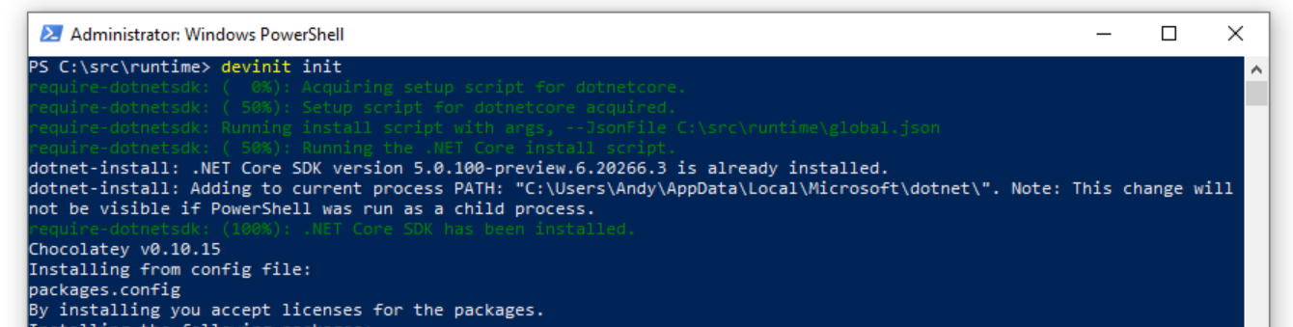
A devinit tool
Each devinit tool is a simple shim to something concrete
A devinit tool just passes on the parameters to the tool they are running (without validation)
Each tool should be isolated from each other tool

Slide 20
How do you use it?
Add a .devinit.json that defines what to run
Add a .devcontainer.json file that in the postCreateCommand executes ‘devinit init’
Profit!

Slide 21
Demo

Slide 22
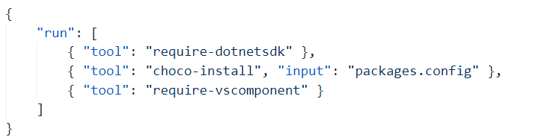
Config file: devinit.json
Tool to run
Each object in the run property is a devinit tool to run identified by the unique name of the tool
Tools are executed in order they are specified
The same tool can be called multiple times (hopefully with diff input…)
.devinit.json
Optional parameters
input – string
addtionalArguments - string
Install .devinit.json
devinit init
Run single tool
devinit run –t require-dotnetsdk

Slide 23
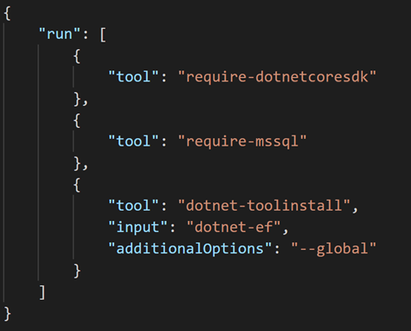
Example: eShopOnWeb https://github.com/dotnet-architecture/eShopOnWeb
.devcontainer.json
PowerShell script to setup the repo
Will run automatically in a Codespace
Can run locally
Executes devinit.json
Executes additional repo specific commands
In the future devinit init might be ran automatically ran in a Codespace
PostCloneSetup.ps1
.devinit.json

Slide 24
Recap
Define your environment in a way it can be reproduced
Devinit is a new tool we’re building to help enable you to do that

Slide 25

Call to Action
Go create .devinit.json files – test it out!
https://aka.ms/devinit/docs
We’d love to hear your feedback!
https://aka.ms/devinit/feedback
devinit can be used from Developer Command prompt in 16.9 Preview 2

Slide 26
Sign up for GitHub Codespaces with Visual Studio
Download Visual Studio Preview (aka.ms/vs-preview)
Sign up for GitHub Codespaces beta (aka.ms/vscs-github)
Learn more about GitHub & Azure integration (aka.ms/GithubActions-Azure)

Slide 27
Visual Studio 2019 16.8 GA and 16.9 Preview
AI-assisted productivity
.NET productivity
Team Completions: Get C# contextual suggestions for your own types, through custom models shared with your team
Roslyn analyzers are now included in the .NET 5.0 SDK
.NET Code Style analyzers can now be enforced on build ^{Preview}
Linux diagnostics
Automated CI/CD workflow ^{Preview}
GitHub Actions workflow from within Visual Studio for your .NET Core apps
.NET Core Debugging with WSL 2 using the Linux distro of your choice ^{Preview}
Debug managed Linux core dump
Git workflows
Easily execute your daily Git operations using the Git Changes window
Browse and manage your Git repository and stop worrying about merge conflicts
XAML productivity
XAML Binding Failures diagnostic improvements
visualstudio.com/download aka.ms/vs-preview
Notes:
Productivity
Roslyn analyzers are now included in the .NET 5 SDK
IntelliSense completion for DateTime and TimeSpan
Inline parameter name hints
With Intellicode team completions, you can train a custom model on your C# codebase & get starred contextual completion suggestions for your own types.
New Git experience
Quickly access your Git shortcuts with a new Git menu
Easily execute your daily Git operations using the Git Changes window
Fluidly browse and manage your Git repository and stop worrying about merge conflicts
Linux Debugging
Debug managed Linux core dump directly in Visual Studio
.NET Core Debugging with WSL 2 using the Linux distro of your choice (Preview)
XAML experience
XAML Binding Failures diagnostic improvements
XAML Hot Reload supports UWP
GitHub Actions (Preview)
- Generate a GitHub Actions workflow from within Visual Studio for your ASP.NET Core apps

Slide 28

Questions?
Thanks for joining!

Slide 29
Backup

Slide 30
Single column of content

Slide 31
Why use GitHub Codespaces?
Cloud-hosted codespaces provide the following benefits:
They're fast to create and disposable. Create as many as you need (up to account limits) and then dispose of them when you are finished.
They're managed, which reduces the overall maintenance for you.
They have predictable pricing and you only pay for what you use with built-in auto-suspend.
They save compute resources. When you move your development workload to the cloud, it frees the limited resources on your personal machine.

Slide 32
GitHub Codespace for Visual Studio
Today for windows, we have Visual Studio to connect to
We have VS Code and browser

Slide 33








Slide 34






Slide 35







Slide 36








Slide 37





Slide 40


Slide 41


Slide 42


Slide 45
Single column of content

